Slide 1
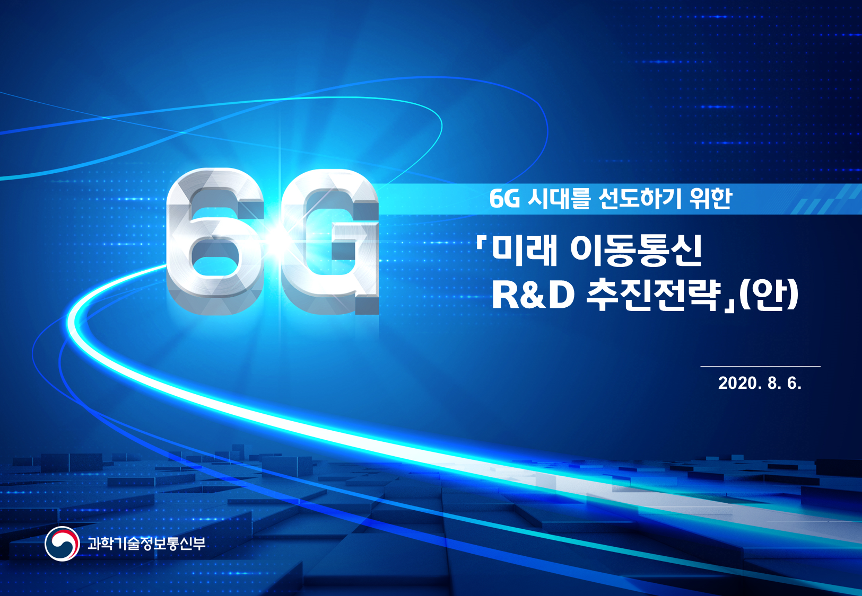
To Lead the 6G Era
R&D Strategies of Future Mobile Communications
2020.Nov. 19th
Ministry of Science and ICT

Slide 2

Ministry of Science and ICT
Contents
「R&D Strategies of Future Mobile Communications」
to lead the 6G Era
CHAPTER
CHAPTER
CHAPTER
Ⅰ
Ⅱ
Ⅲ
Background &
Development
Trends & Implications
Vision & Strategies
CHAPTER
CHAPTER
Ⅳ
Ⅴ
Key Action Plans
Implementation System

Slide 3

Ⅰ. Background & Development
Need to fully Prepare for 6G,
securing future competiveness & responding to technological hegemony
World’s 1st 5G Commercialization
Securing global competitiveness
through
Early market exploration
Mobile Com. Infrastructure
non-contact/digital Transformation
10-year cycle
Fierce competition by Generation
COVID19-led
Growing demands for
High quality & reliable Network
1G (‘79, 1st by Japan)
2G (’91, EU(GSM)/’96, Korea (CDMA))
3G (’01, 1st by Japan)
4G (’09, 1st by EU)
5G (’19, 1st by Korea)
6G (Commercialization
expected btw ‘28-30)
‘K-New Deal’ for 5G
KRW 70bn investment from
Supplementary Budget
「Provisional R&D Strategies of Future Mobile Communications」 to lead the 6G era
/ 16

Slide 4

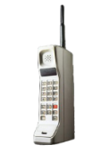

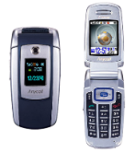










Ⅰ. Background & Development
이동통신 세대별 현황
Mobile Com. by Generation
1G
2G
3G
4G
5G
6G
Technology
Analog
GSM
WCDMA
LTE
NR(New Radio)
CDMA
CDMA 2000
WiBro
Trans
mission
Speed
(Movie download)
- | 14.5~153.6kbps (32hrs) | 2~14.4Mbps (19min) | 75Mbps~1Gbps (16sec) | 20Gbps (Below 1sec(0.8sec)) | 1,000Gbps
Voice | Voice·Text | Photo·Music·Video Call | HD Video(Smartphone) | VR·AR·Self-driving car | Hologram, Flying Car (Satellite-based)
Service
Key
Company
Mobile
?
Equipment
※ The size of a company’s logo stands for its market share.
「Provisional R&D Strategies of Future Mobile Communications」 to lead the 6G era
/ 16

Slide 5
Ⅰ. Background & Development
01
Initiated research on preliminary feasibility (Sep 2018)
02
Industry-Academia-R&D Experts Meetings [92 sessions (Nov 2018-July 2019 ]
03
Public hearing (July 2019)
* 200 participants from 5G-related industries, academia, research agencies, and media
04
Passed technology evaluation (Sep 2019)
Applied preliminary feasibility study (PFS) (Oct 2019)
Suggested two-phase projects (8 yrs→5+3yrs)due to external uncertainties
* (1st phase) Core Tech. development(5yrs: ’21to’25) / (2nd phase) Support for commercialization(3 yrs:’26 to’28)
05
06
Passed PFS[Apr 2020 for 5yrs(’21to’25) KRW 200bn]
* For 5G R&D(‘Giga Korea’ project): KRW 550bn for 8yrs
6G 시대를 선도하기 위한 「미래 이동통신 R&D 추진전략」(안)
「Provisional R&D Strategies of Future Mobile Communications」 to lead the 6G era

Slide 6

Ⅱ. Trends & Implications
6G becoming a core infrastructure in an intelligent, un-tact society,
beyond the limitations of 5G
Towards Intelligent, Non-Contact Society
1Tbps
Non-contact
Hyperreality Service
Remote surgery
Remote Working
Nation-wide Smart City
Low orbit satellite
6G communications
1Tbps Speed
(1Tbps = 1,000Gbps)
Remote /real-time surgery
Golden time secured
Smart AI
Com./Auto Control
Com. service
Up to 10km
from the ground
[Hyper performance
Hyper bandwidth]
[Hyper precision]
[Hyper intelligence]
[Hyper space]
Embedded Security by Design [Hyper Trust]
IT convergence in other industries
Global
Market
Forecast
Sales
(USD bn)
Annual Growth
3,281
13.3%
B2B Market
1,736
Smartphone-centered
service
1,497
1.5%
B2C Market
[Source]
Ericsson (2017)
939
2016
2021
2026
(Year)
6G 시대를 선도하기 위한 「
「Provisional R&D Strategies of Future Mobile Communications」 to lead the 6G era

Slide 7

Ⅱ. Trends & Implications
Global competition already started
to become the 1st mover in 6G Tech. & standards
EU
China
USA
Japan
Established 6G flagship
(’18~’25, KRW 300bn)
Government-led 6G R&D
(’19~’25, KRW 460bn )
Official agency for 6G (’19)
DARPA-led 6G R&D
(’17~’21, KRW 225bn)
ATIS-led NEXT G Alliance
for 6G Network (’20)
Public-Private research committee (’20)
Developing Comprehensive 6G strategy
4G
5G
6G
2002
2013
2021
R&D Initiated
2008
R&D Initiated
2018
R&D
2027
Standardization
Completed
Standardization
Completed
Standardization
2yrs
2yrs
2011
2019
2028
Commercialization
Commercialization
Commercialization
NOW is the time to start 6G R&D!
5G: PFS, a year after 4G commercialization, R&D in 2013
leading 5G global standards succeed the world’s 1st commercialization
「Provisional R&D Strategies of Future Mobile Communications」 to lead the 6G era

Slide 8

Ⅱ. Trends & Implications
Ⅱ. 국내외 동향 및 시사점
Korea achieved the world’s first 5G commercialization
but left much to be desired
Preemptive R&D
5G Standards Patent
5G+ Strategy Committee
Achievement
World’s 1st 5G commercialization,
technology overseas transfer
Global share in the 1st year
Device: 1st / Equipment: 3rd
Active investment in convergence,
Co-growth of SMEs
Compare to B2C
CN, USA, etc.
Core Components
Uncertain revenue model
for B2B, B2G
convergence service
Fierce global competition,
Still high dependency on
overseas patents
High dependency on
foreign parts,
Lack of Experts
Limitation
Delayed launch of
28GHz industrial equipment/device
Annually USD 2bn to foreign companies
for patents (’19, KIPO)
(Device/Optical) 80~90% from JP, USA
Lack of 4,000 network experts (till ’23)
6G 시대를 선도하기 위한 「미래 이동통신 R&D 추진전략」(안)
/ 16
「Provisional R&D Strategies of Future Mobile Communications」 to lead the 6G era

Slide 9
Ⅲ. Vision & Strategy
Strategies to be Global No. 1 in 6G
Vision
Leading 6G Era: Imagination into reality
Goal
“
World’s 1st 6G commercialization:
Securing core technology, laying a basis to lead the global 6G market
”
Strategy
Next Gen. Tech.
Standards/Patent
Infrastructure
Developing
High risk 6G core technology
(Not covered by private investment)
Leading global standardization
Securing standard patents
Preemptive localization
Nurturing the best workforce
- 6 Technologies & 10 Action Plans
- Global joint research &
Tech. exchange
- Pilot programs of strategic
industries
- Global standards of
R&D achievements
- Leadership in global standards
- Providing Package services
(R&D + Standards + Patent)
- Localizing 6G core components /equipment
- Fostering qualified workforce
Securing a leading position in Tech standards amid intense global competition
minimized implications of external uncertainties
「Provisional R&D Strategies of Future Mobile Communications」 to lead the 6G era

Slide 10
Ⅳ. Key Action Plans
1-1
Preemptively securing world’s best 6G technology beyond 5G
Strategy
6G Tech. Goal&R&D Investment
1Tbps transmission speed,
Latency 1/10 of 5G
(0.1ms, wired below 5ms)
Limited
5G capacity :
End-to-end
delay
AI Technology to entire network
(From core to wireless network)
Partial apply of AI to NW
10 Core technologies of 6G
overcoming 5G imitations
(total 214.7 bn)
Service expansion:
Up to 10㎞ from the ground
( Flying car/ Drone control thru
low orbit satellite 6G Com.)
Non-Contact society,
Security threat
Security by Design embedded from the ground on
(5G: Security was Add-on)
Ground-
Centered
Service
Global Cooperation Flexibility and Active Interaction

Slide 11
Ⅳ. Key Action Plans
Implementing pilot projects in parallel for 6G Technology
to be delivered as services
1-2
Strategy
6G-Upgrade Pilot Project
6G Tech. development & Service demonstration in parallel
→ finding a 6G B2B revenue model at early stage
5G
6G
Mobile-based 24/7
health management
(Blood sugar/pressure, exercise)
Digital Health Care
UP
Quantum cryptography-based
biometric encryption, remote surgery
Immersive Contents
UP
Remote, real-time,
Non-contact, holographic
conference
Mobile AR‧VR broadcasting
Car-to-Car, Car-to-Infra
Ultra low latency
Autonomous Vehicles
UP
6G satellites:
Flying cars, drone,
ultra low latency com.
Post Office’s drone delivery
to Mountainous areas :
30 min by car -> only 6min
Smart City
UP
Digital twin :
Digital reproduction/control of
logistical/transport entities
Big data-based
safe, optimized and automatic
control of industrial sites
Going wireless from
wired manufacturing lines
Smart Factory
UP
「Provisional R&D Strategies of Future Mobile Communications」 to lead the 6G era

Slide 12
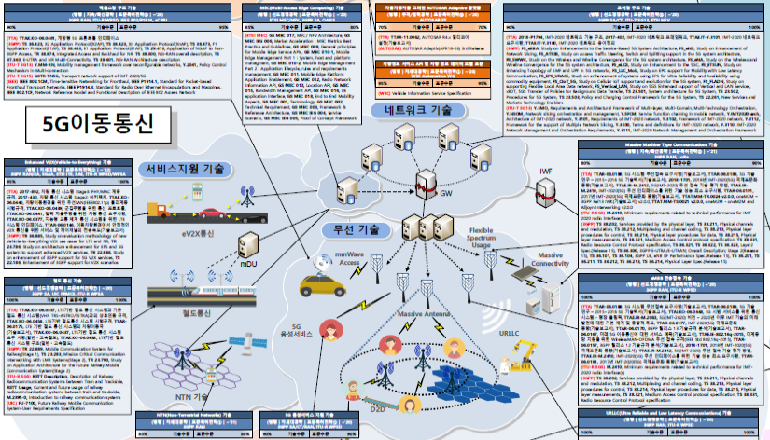


Ⅳ. Key Action Plans
Becoming the first mover in global standards,
Securing high value added standard patents
2
Strategy
Global standards of
R&D achievement
Global standards leadership
Total care of
‘R&D·Standard·Patent’
Applying to 3GPP, ITU Standards of 6G core Tech.
Preemptive response to global hegemony battle
Global joint research & train standard experts
Supporting domestic standardization activities
Building strategic map of com. tech. with KIPO
→ providing direction for IP-R&D
→ developing patents/standards
6G
6G Mobile
standards
+Patent
[Source] TTA,ICT Standard Strategy Map
6G Standardization
l Expected schedule of ITU 6G Global Standardization activity from’21
Domestic Superior Technologies
Domestic Standard Patents
Establish Vision
Define Requirements
Candidate Tech.
Tech. Evaluation /
Adopt Global Standards
2020
2021
2022
2023
2024
2025
2026
2027
2028
2029
「Provisional R&D Strategies of Future Mobile Communications」 to lead the 6G era

Slide 13
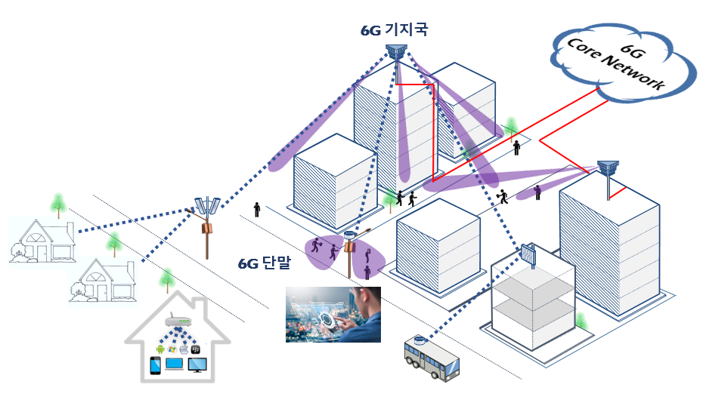
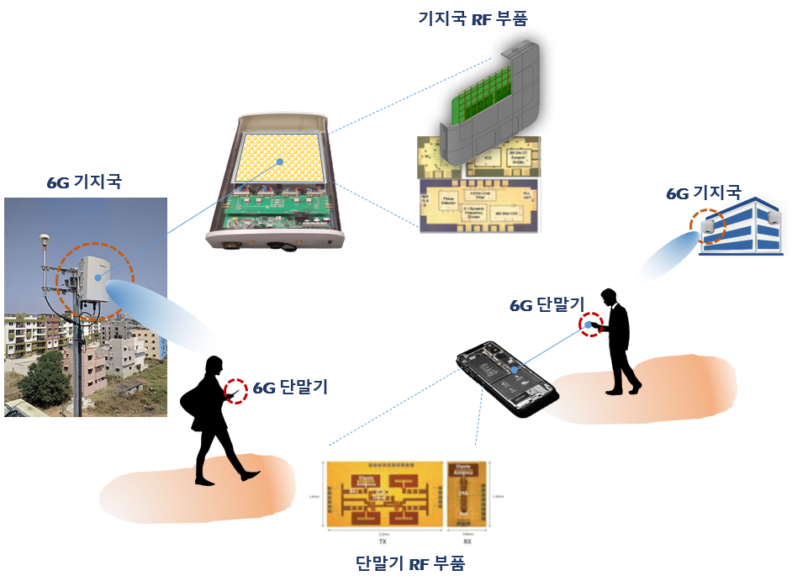
Ⅳ. Key Action Plans
Laying a firm foundation for research and industries
thru localized core parts/equipment and qualified workforce
3
Strategy
KR Prototype(HW, SW) Development
R&D support
for SMEs
Nurturing the best and brightest
More Network Research Centers
Key Prototypes (provisional)
2 in 2020 6 in 2022
Mobile/Optical Com.
RF
Hands-on/convergence workforce
Industry-academia partnership system:
Stronger 6G workforce
University
Company
Support field training
of university students
Student mentoring
Support companies’ R&D
Workers retraining
Date signal processing
components/equipment:
50x faster than 5G
(for in(out)door base stations, devices)
Platform for knowledge sharing
Devices/components for bandwidth above 100GHz (not used in 5G)
Educational contents for 6G Tech. development
(MOOC)
Real-time sharing of best ideas/knowhow
「Provisional R&D Strategies of Future Mobile Communications」 to lead the 6G era

Slide 14



Ⅴ. Implementation System
Enhancing capabilities of industry, academia, private experts,
Flexible responding to external uncertainties
Establishing ‘6G R&D Strategy Committee’ and sub project units
involving experts from industry, academia, R&D agencies, and private sector
3 Major
Telecom
Carriers
MSIT
5G Forum/
KICS
6G R&D
Strategy
Committee
Decision-Making
for 6G Projects
Manufacturer
(Large/SME)
KIEES/
OSK
Target Assess / Amend
proposal
Agenda review / Decision
(Rolling Plan)
6G Core Tech.
Development
Project Unit
Project planning
Review
Outcome management
Sub Unit
Rolling plan based on Tech. trend, R&D progress
Tech./Standards Unit
Frequency Unit
Global Cooperation Unit
Mobile/Optical Com., Satellite,
RF, Network, R&D in cybersecurity
Channel modeling,
Frequency safety, exploration
Cooperation agenda,
Global trends monitoring
6G 시대를 선도하기 위한 「미래 이동통신 R&D 추진전략」(안)
/ 16
「Provisional R&D Strategies of Future Mobile Communications」 to lead the 6G era

Slide 15

Thank you!
Leading
Imagination into Reality
Ministry of Science and ICT

